Slide 1
Multilinear Reference Tissue Model 0 (MRTM0)
Sep 22, 2023
Zeyu Zhou
MIRA Group Meeting Review

Slide 2





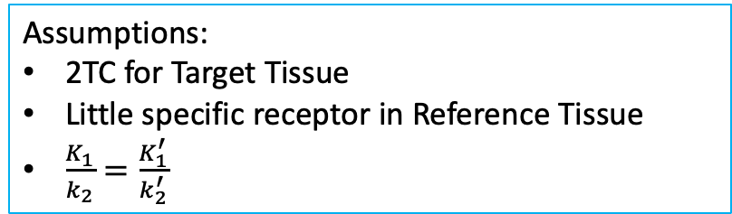

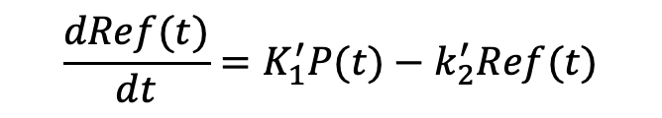




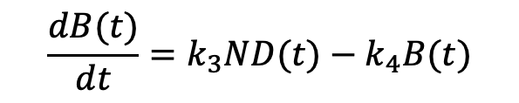

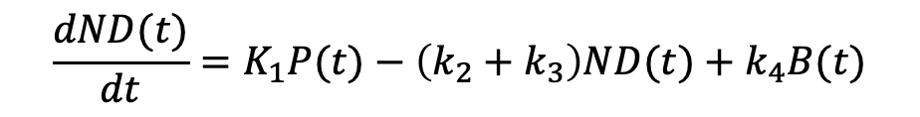

Reference Tissue Model
Assumptions:
2TC for Target Tissue
Little specific receptor in Reference Tissue
$\frac{K_{1}}{k_{2}}=\frac{K_{1}^{′}}{k_{2}^{′}}$
Target Tissue
$$T$$
$$K_{1}$$
$$k_{3}$$
$$\frac{dND(t)}{dt}=K_{1}P(t)−\left(k_{2}+k_{3}\right)ND(t)+k_{4}B(t)$$
$$ND$$
$$B$$
$$\frac{dB(t)}{dt}=k_{3}ND(t)−k_{4}B(t)$$
$$k_{2}$$
$$k_{4}$$
$$T(t)=ND(t)+B(t)$$
$$P$$
$$\frac{dRef(t)}{dt}=K_{1}^{′}P(t)−k_{2}^{′}Ref(t)$$
$$K_{1}^{′}$$
$$Ref$$
$$k_{2}^{′}$$
Reference Tissue

Slide 3


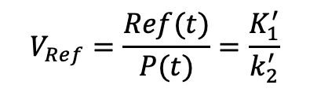

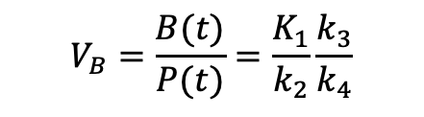


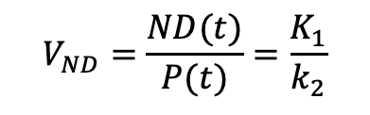

Reference Tissue Model
Assumptions:
2TC for Target Tissue
Little specific receptor in Reference Tissue
$\frac{K_{1}}{k_{2}}=\frac{K_{1}^{′}}{k_{2}^{′}}$
Target Tissue
$$T$$
$$K_{1}$$
$$k_{3}$$
$$\frac{dND(t)}{dt}=K_{1}P(t)−\left(k_{2}+k_{3}\right)ND(t)+k_{4}B(t)$$
$$ND$$
$$B$$
$$\frac{dB(t)}{dt}=k_{3}ND(t)−k_{4}B(t)$$
$$k_{2}$$
$$k_{4}$$
$$T(t)=ND(t)+B(t)$$
$$P$$
$$\frac{dRef(t)}{dt}=K_{1}^{′}P(t)−k_{2}^{′}Ref(t)$$
$$K_{1}^{′}$$
After equilibrium time $t_{e}$:
$$t≥t_{e}$$
$$Ref$$
$$V_{ND}=\frac{ND(t)}{P(t)}=\frac{K_{1}}{k_{2}}$$
$$V_{Ref}=\frac{Ref(t)}{P(t)}=\frac{K_{1}^{′}}{k_{2}^{′}}$$
$$k_{2}^{′}$$
$$V_{B}=\frac{B(t)}{P(t)}=\frac{K_{1}}{k_{2}}\frac{k_{3}}{k_{4}}$$
$$T\left(t\right)=aP(t)$$
$$Ref\left(t\right)=a^{′}P(t)$$
Reference Tissue
$$=V_{ND}+V_{B}=\frac{K_{1}}{k_{2}}\left(1+\frac{k_{3}}{k_{4}}\right)$$
$$=V_{Ref}=\frac{K_{1}^{′}}{k_{2}^{′}}$$

Slide 4









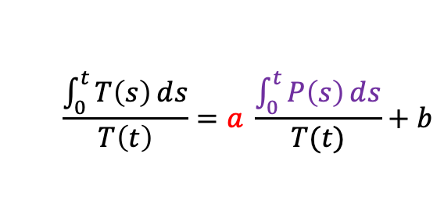



Multilinear Reference Tissue Model
$$=V_{ND}+V_{B}=\frac{K_{1}}{k_{2}}\left(1+\frac{k_{3}}{k_{4}}\right)$$
$$=V_{Ref}=\frac{K_{1}^{′}}{k_{2}^{′}}$$
Target Tissue
$$T$$
$$T\left(t\right)=aP(t)$$
$$Ref\left(t\right)=a^{′}P(t)$$
$$t≥t_{e}$$
Idea by Logan et. al.
$$\frac{\int_{0}^{t}{T\left(s\right)ⅆs}}{T\left(t\right)}=a \frac{\int_{0}^{t}{P\left(s\right)ⅆs}}{T(t)}+b$$
$$K_{1}$$
$$k_{3}$$
$$ND$$
$$B$$
$$k_{2}$$
$$k_{4}$$
$$P$$
$$K_{1}^{′}$$
$$Ref$$
$$k_{2}^{′}$$
Reference Tissue

Slide 5
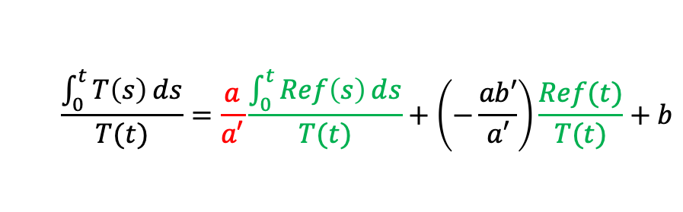
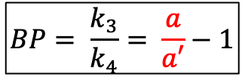
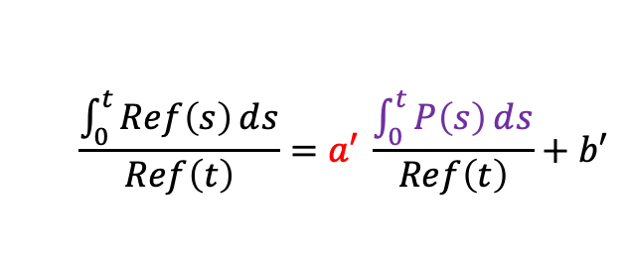

Multilinear Reference Tissue Model
$$=V_{ND}+V_{B}=\frac{K_{1}}{k_{2}}\left(1+\frac{k_{3}}{k_{4}}\right)$$
$$=V_{Ref}=\frac{K_{1}^{′}}{k_{2}^{′}}$$
Target Tissue
$$T$$
$$T\left(t\right)=aP(t)$$
$$Ref\left(t\right)=a^{′}P(t)$$
$$t≥t_{e}$$
Idea by Logan et. al.
$$\frac{\int_{0}^{t}{T\left(s\right)ⅆs}}{T\left(t\right)}=a \frac{\int_{0}^{t}{P\left(s\right)ⅆs}}{T(t)}+b$$
$$\frac{\int_{0}^{t}{Ref\left(s\right)ⅆs}}{Ref\left(t\right)}=a′ \frac{\int_{0}^{t}{P\left(s\right)ⅆs}}{Ref\left(t\right)}+b′$$
$$K_{1}$$
$$k_{3}$$
$$ND$$
$$B$$
$$k_{2}$$
$$k_{4}$$
$$\frac{\int_{0}^{t}{T\left(s\right)ⅆs}}{T(t)}=\frac{a}{a′}\frac{\int_{0}^{t}{Ref\left(s\right)ⅆs}}{T(t)}+\left(−\frac{ab′}{a′}\right)\frac{Ref(t)}{T(t)}+b$$
$$P$$
Multi-linear
$$K_{1}^{′}$$
$$Ref$$
$$BP= \frac{k_{3}}{k_{4}}= \frac{a}{a′}−1$$
Assuming $\frac{K_{1}}{k_{2}}=\frac{K_{1}^{′}}{k_{2}^{′}}$
$$k_{2}^{′}$$
Reference Tissue

